Slide 1
Comparing Price Measures—
The CPI and the PCE Price Index
Kyle Brown, Chief, PCE Branch
NABE 14th Annual Economic Measurement Seminar, Washington, DC, July 17th – 18th, 2017

Slide 2
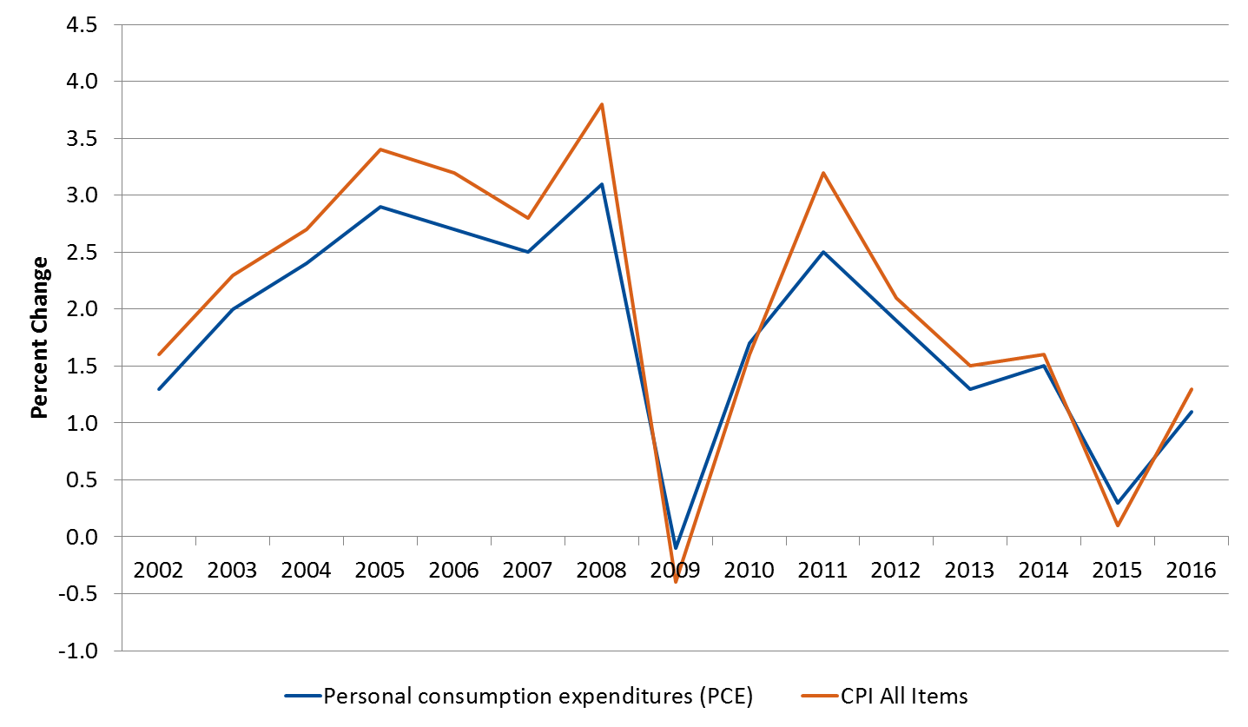
The PCE Price Index and the CPI

Slide 3
What are the Differences?
PCE Price Index | CPI
Produced by BEA using BLS price indexes and other data sources. | Produced by BLS using surveys of consumer prices and other data sources.
Reflects the price of expenditures made by households, including those made on behalf of households. [PCE constitutes about 70% of the GDP, so the PCE price index covers a substantial portion of U.S. economic transactions] | Reflects the price of out-of-pocket expenditures made by consumers.
Composition of expenditures changes from quarter to quarter. [composition also changes from month to month] | Composition of the market basket remains fixed (updated every two years).
Derived using a chained Fisher index formula. | Derived using a Laspeyres-type index formula.
Weights are derived from business surveys. [Such as the Monthly Retail Trade Survey, the Quarterly Services Survey] | Weights are derived from household surveys. [The Consumer Expenditure Survey]

Slide 4
Composition of the PCE Price Index
Type of Index | Share of Nominal PCE
CPI | 71 percent
PPI | 12 percent
Input-cost Indexes | 13 percent
Other | 4 percent

Slide 5
Weights
CPI Expenditure Category | December 2015
 | PCE Weights | CPI Weights | PCE less CPI
All items | 100.0 | 100.0 | --
Food and beverages | 12.9 | 15.0 | -2.1
Housing | 23.6 | 42.2 | -18.6
Shelter | 16.4 | 33.2 | -16.8
Other housing | 7.2 | 9.0 | -1.8
Apparel | 3.8 | 3.1 | 0.7
Transportation | 10.4 | 15.3 | -4.9
Medical care | 22.0 | 8.4 | 13.6
Recreation | 7.6 | 5.7 | 1.9
Education and communication | 6.2 | 7.1 | -0.9
Other goods and services | 13.4 | 3.2 | 10.2

Slide 6
Medical Care: An Example of Differences
PCE Price Index includes health care paid for by
        Households [Corresponds to the CPI scope]
        Employers
        Government programs
Weight Differences
Price Differences—PPIs used for
        Hospitals
        Physicians
        Nursing homes
        Home health care

Slide 7
Scope-adjusted Weights¹
CPI Expenditure Category | December 2015
 | PCE Weights | CPI Weights | PCE less CPI
All items | 100.0 | 100.0 | --
Food and beverages | 17.2 | 15.0 | 2.2
Housing | 31.8 | 42.2 | -10.4
Shelter | 21.8 | 33.2 | -11.4
Other housing | 10.0 | 9.0 | 1.0
Apparel | 5.1 | 3.1 | 2.0
Transportation | 14.5 | 15.3 | -0.8
Medical care | 8.0 | 8.4 | -0.4
Recreation | 8.5 | 5.7 | 2.8
Education and communication | 6.8 | 7.1 | -0.3
Other goods and services | 8.1 | 3.2 | 4.9
^{1.} PCE weights are adjusted (by including or excluding items) to match the content of the CPI.

Slide 8
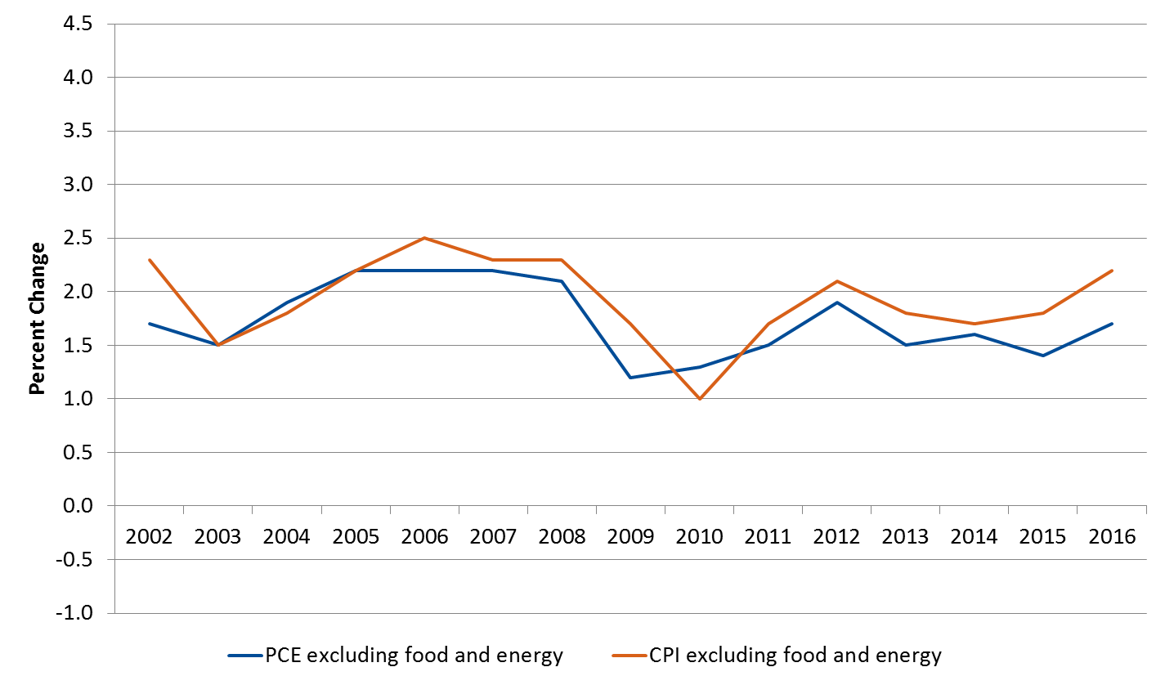
Core Price Indexes

Slide 9
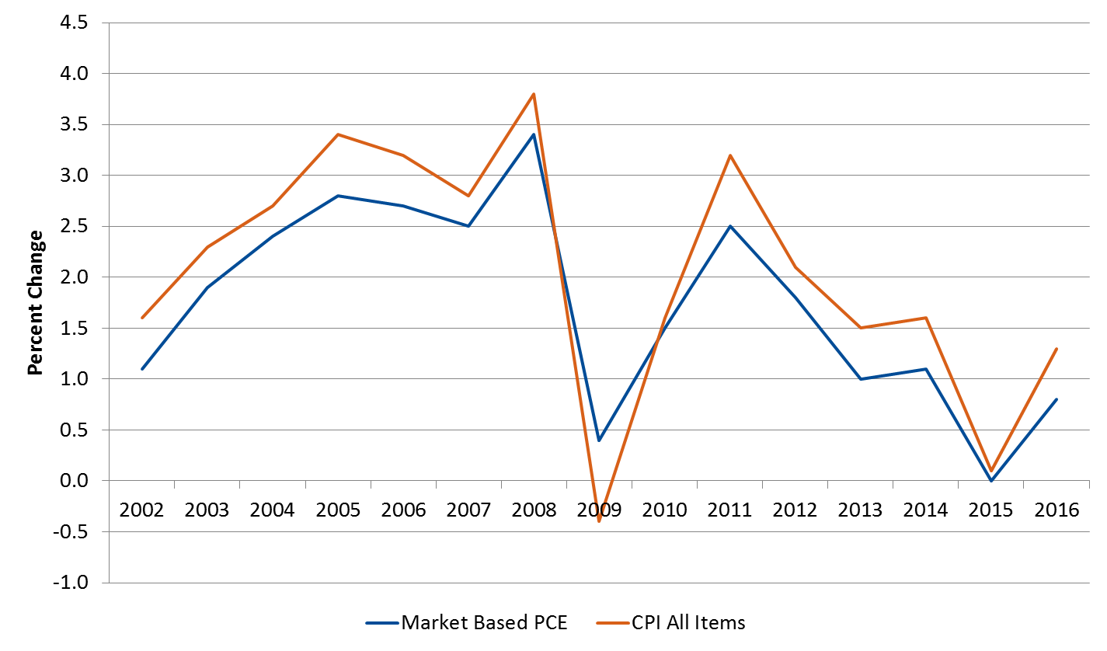
Market-based PCE Price Index

Slide 10
PCE Contact Information
Kyle Brown, Branch Chief, (301) 278-9688, kyle.brown@bea.gov
Ricardo Limes, Section Chief - Goods, (301) 278-9659, ricardo.limes@bea.gov
Harvey Davis, Section Chief - Services, (301) 278-9719, harvey.davis@bea.gov

